Slide 1
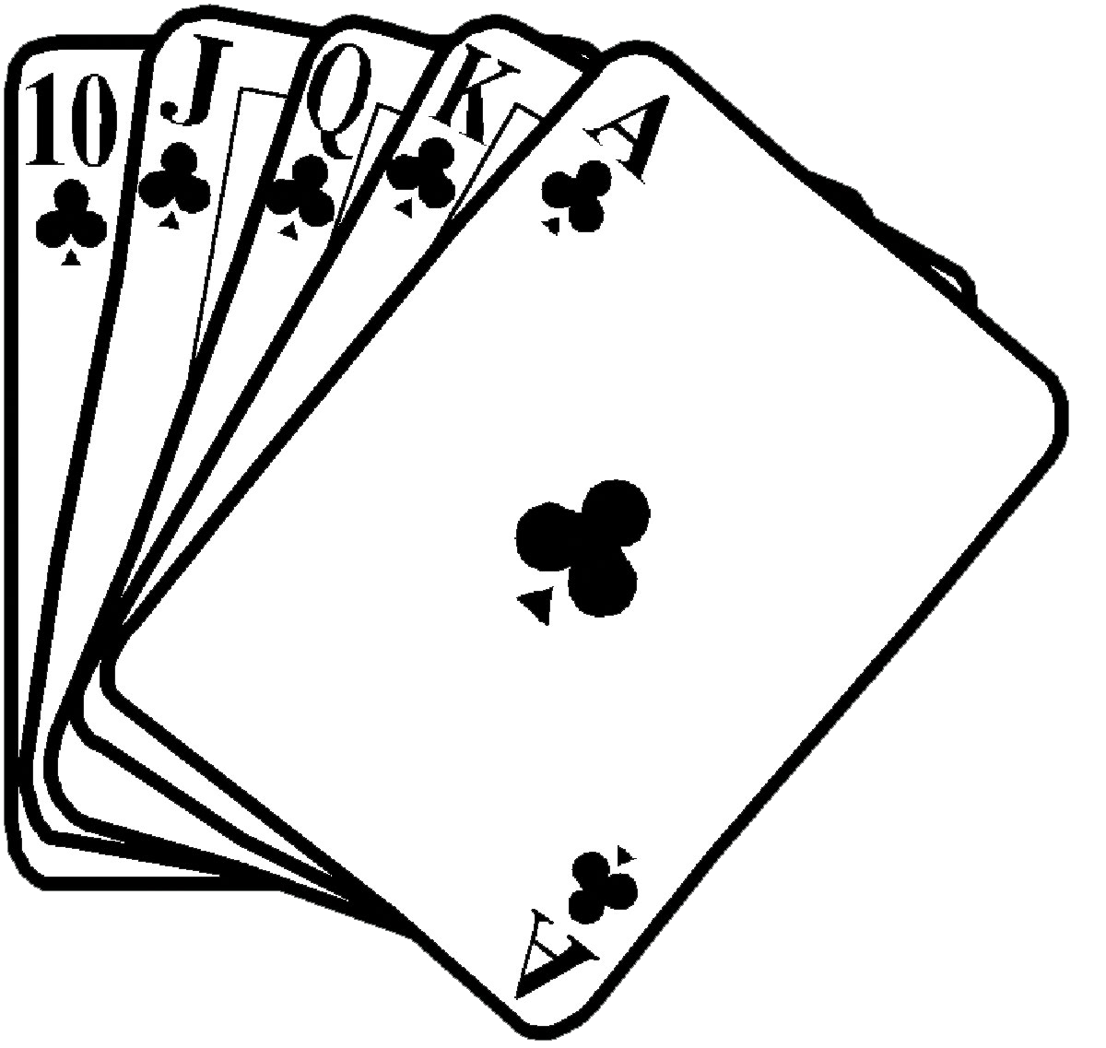
Classifying Poker Hands
Michael Neas, Sean Bridges, Cindy Lin, Angela Onofrio, Daniel DeMarco, Edward Hanlon, Nicholas Barber

Slide 2
Objective
Through the use of several classification algorithms, compare the results to analyze which algorithm performs best at classifying various poker hands. The algorithms we plan to evaluate are
Support Vector Machine
K-Nearest Neighbor
Decisions Trees
Linear Discriminant Analysis
We will use various metrics for performance evaluation for the purpose of model comparison, such as accuracy with confusion matrices and cost matrices. For model comparison we considered the sensitivity-specificity between models.

Slide 3
Dataset
https://archive.ics.uci.edu/ml/datasets/Poker+Hand
Training Data : 25,000+ poker hands
Test Data : 1,000,000 poker hands
Each line is showing a hand consisting of five playing cards drawn from a 52 card deck. Each card is has a suit and rank attribute, totaling 10 predictive attributes. Lastly, there is one “Class” attribute to describe the Poker Hand.
The order of cards is important, for example there are 480 possible Royal Flush hands as compared to 4.

Slide 4
Example
Suit_1, Rank_1, Suit_2, Rank_2, Suit_3, Rank_3, Suit_4, Rank_4, Suit_5, Rank_5, Class
1, 10, 1, 11, 1, 13, 1, 12, 1, 1, 9
0: Nothing in hand; not a recognized poker hand
1: One pair; one pair of equal ranks within five cards
2: Two pairs; two pairs of equal ranks within five cards
3: Three of a kind; three equal ranks within five cards
4: Straight; five cards, sequentially ranked with no gaps
5: Flush; five cards with the same suit
6: Full house; pair + different rank three of a kind
7: Four of a kind; four equal ranks within five cards
8: Straight flush; straight + flush
9: Royal flush; {Ace, King, Queen, Jack, Ten} + flush

Slide 5
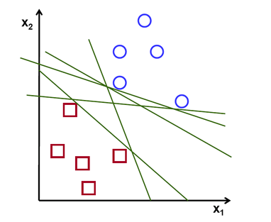
Support Vector Machine (SVM) Overview
Classifier defined by a separating hyperplane.
Which line is the best?

Slide 6
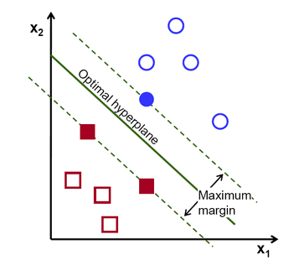
Support Vector Machine (SVM) Overview
SVM algorithm is based on finding the hyperplane that gives the largest minimum distance to the training examples
Aka, twice that distance is the optimal hyperplane that maximizes the margin of the training data
Notes:
A line is bad if it passes too close to the points because it will be noise sensitive and it will not generalize correctly. Therefore, our goal should be to find the line passing as far as possible from all points.

Slide 7
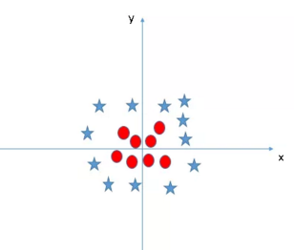
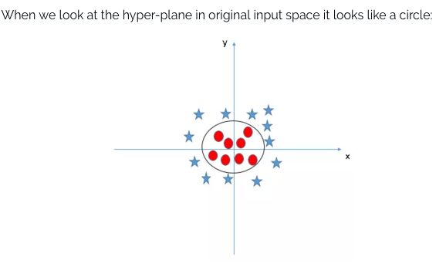
What Happens If Data Isn’t Linear?
SVM has a technique called kernel trick.
These functions takes low dimensional input space and transform it to a higher dimensional space
Basically, does extremely complex data transformations and then find out a process to separate the data
Notes:
VM has a technique called the kerneltrick. These are functions which takes low dimensional input space and transform it to a higher dimensional space i.e. it converts not separable problem to separable problem, these functions are called kernels. It is mostly useful in non-linear separation problem. Simply put, it does some extremely complex data transformations, then find out the process to separate the data based on the labels or outputs you’ve defined.

Slide 8
Parameters Used for SVM algorithm
Type of SVM: C-Support Vector Classification -- can be used for n class classification
C value: 1
The C parameter tells the SVM optimization how much you want to avoid misclassifying each training example
Kernel: Linear & RBF (radial basis function)
Notes:
For large values of C, the optimization will choose a smaller-margin hyperplane if that hyperplane does a better job of getting all the training points classified correctly. Conversely, a very small value of C will cause the optimizer to look for a larger-margin separating hyperplane, even if that hyperplane misclassifies more points. For very tiny values of C, you should get misclassified examples, often even if your training data is linearly separable.
up vote1down votefavorite
1
The non-linear kernels allow the SVM to separate non-linear data linearly in a high dimensional space. The RBF kernel is probably the most popular non-linear kernel.
I was told that the RBF kernel is Gaussian, and therefore is infinitely differentive. With this property, the RBF kernel can map the data from a low dimensional space to an INFINITE dimensional space. I have 2 questions:

Slide 9
Output
Linear: RBF:
Accuracy: 0.9996 Accuracy: 0.9981

Slide 10
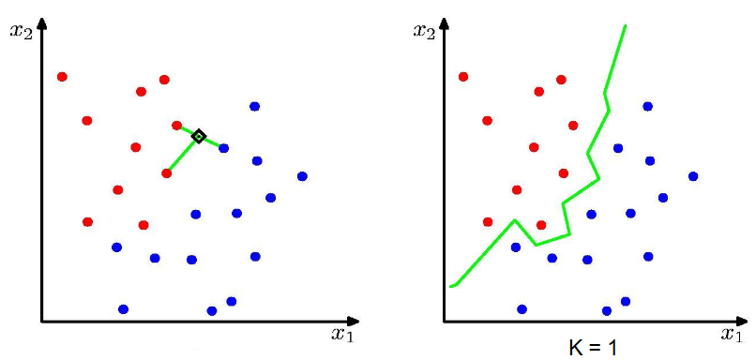
K-Nearest Neighbor Overview
Notes:
Notes on kNN algorithm;
Nonparametric, model free method for classifying test examples based on closest training examples in the feature space.
First, classify the training samples. Then for each test example run through the training set to determine the class of the test examples “k” nearest neighbors. A majority vote of the closest neighbors determine the class of the test example.
K acts as a smoother.
This is efficient once fitted, but takes a lot of calculation to achieve this initial fit.

Slide 11
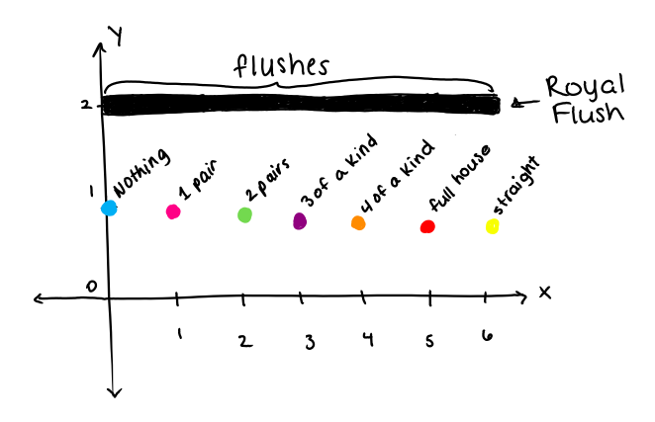
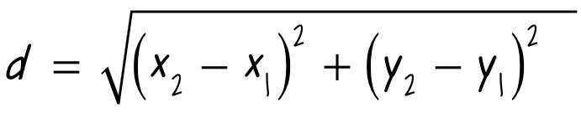
Handling multidimensional data?
•Reclassify into two dimensional data that can be represented readily
Euclidean distance:
Results?
Notes:
In order to easily represent and calculate the distance between points, we decided to use a two dimensional graph to represent the data. Each data entry is assigned an “x” and a “y” value that can be plotted on the graph. The y-value takes the suits of the cards, and the x-value takes the ranks of the cards, as well as the y-value. The y-value will determine whether or not the hand will be a flush. If the suits are all the same, we know it is some type of flush, whether it be a regular flush, a straight flush, or a royal flush. We give this y-value a “2”. The method that determines the x-value will first use the y-value to check if the hand is a flush or not. If so, it will return the sum of the ranks. Otherwise, it checks to see how many of each card there are. If the two highest amount of cards is a 2 and a 1, it returns “1”, for “1 pair”. If the two highest amounts of cards are both 2, it returns a “2” for “2 pairs”. If the two highest is 3 and 1, “3 of a kind”. If the two highest amounts are 3 and 2, “full house”, which it will assign the number 5 to. 4 is “4 of a kind”, and it will also check to see if it is a straight, which it will assign the number 6 to. This way, each class should have it’s own spot on the graph. This is run on both the training data and the test data.
Next, for every (x,y) ordered pair in the test data, it will calculate the distance between it and every ordered pair from the training data. It will take the classification of the closest point (found in the last column of the dataset) and assign it to the point in the test data. Since we have the correct classifications in the last column of the test dataset, we can verify if they are correct or not. This will determine how accurate the classification method is on this dataset and also help us determine the ROC curve for this algorithm. Once this part of the process is completed, we will have our results.

Slide 12
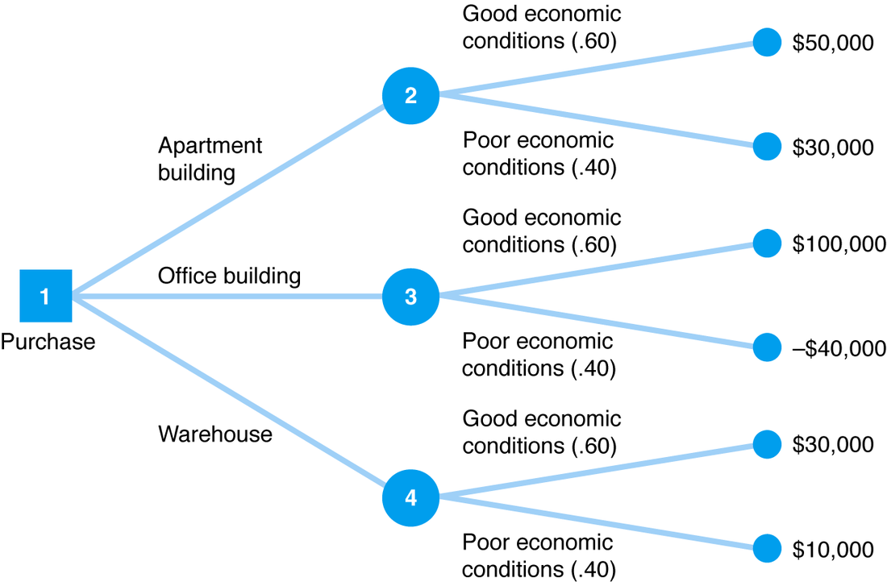
Basics of Decision Trees
Decision Trees break problem inputs in attributes
Typically every level of the tree is a decision about the attributes
These branching decisions are based off whether an attribute is true or false, or greater than or less than a specified target
White Box solutions

Slide 13
Decision Trees
CART (Classification and Regression Trees) implementation
Combined classification and regression algorithm
Recursively partition data space and fit a prediction with each partition (greedy)
Non-parametric (no assumptions about probability distributions)
Decision Trees are most famously used on the Iris classification problem
This problem is similar to the classification of the pokers hands
Potential Problems
Pokers hand classification is not necessarily based on the magnitude of the hands
i.e. greater than and less than may not be an ideal metric for our data
Combinations of numerically lower value cards can increase the cumulative hand value
Notes:
(Iterative Dichotomiser 3) was developed in 1986 by Ross Quinlan. The algorithm creates a multiway tree, finding for each node (i.e. in a greedy manner) the categorical feature that will yield the largest information gain for categorical targets. Trees are grown to their maximum size and then a pruning step is usually applied to improve the ability of the tree to generalise to unseen data.
C4.5 is the successor to ID3 and removed the restriction that features must be categorical by dynamically defining a discrete attribute (based on numerical variables) that partitions the continuous attribute value into a discrete set of intervals. C4.5 converts the trained trees (i.e. the output of the ID3 algorithm) into sets of if-then rules. These accuracy of each rule is then evaluated to determine the order in which they should be applied. Pruning is done by removing a rule’s precondition if the accuracy of the rule improves without it.
C5.0 is Quinlan’s latest version release under a proprietary license. It uses less memory and builds smaller rulesets than C4.5 while being more accurate.
(Classification and Regression Trees) is very similar to C4.5, but it differs in that it supports numerical target variables (regression) and does not compute rule sets. CART constructs binary trees using the feature and threshold that yield the largest information gain at each node.
scikit-learn uses an optimised version of the CART algorithm.

Slide 14
Decision Tree Results
48% prediction accuracy from a subset of the test data.
Decision trees tend to overfit with large classifiers
76 seconds to query all million test hands
O(log(n _{training data})) to query the tree for a single test hand

Slide 15
Plan Forward
Prune the data to reduce the size of the tree and avoid overfitting.
Graph error based on accuracy of predicting class of hand in test data.
Graphical visualization of the decision tree from after being trained on training data.

Slide 16
Linear Discriminant Analysis
Can be used for classification, but typically used to reduce dimensionality and prevent overfitting.
Initially assumes normal distribution for mean and variance, and that class covariances are identical.
Steps
Find mean m_{i} of attributes for each instance.
Find within-class scatter matrix, S_{w}, by summing (m_{c} - m_{i})(m_{c} - m_{i})^{T} over all classes where m_{c} is mean of all instance attributes in a class and m_{i} is as above for all instances belonging to it. Likewise, between-class scatter matrix, S_{B}, can be found by (m_{i} - m)(m_{i} - m)^{T} where m is the mean of all instance attributes over all classes.

Slide 17
Linear Discriminant Analysis
Steps (con’t)
Solve S_{w}⁻¹S_{B} for eigenvalues.
Observe smallest eigenvalues. Since these represent the magnitude of a covariance and therefore have the least influence on classification, they can be eliminated to reduce dimensional space.
The k eigenvectors corresponding to the remaining eigenvalues form a k x d dimensional matrix W.
The resulting subspace can be represented by Y = X x W, where X is the starting n x d matrix where n is the number of instances and d are the attributes for each, and W is as above.

